Slide 1
North South University Campus AI Assistant

Slide 2

Websites can be huge and confusing

Slide 3
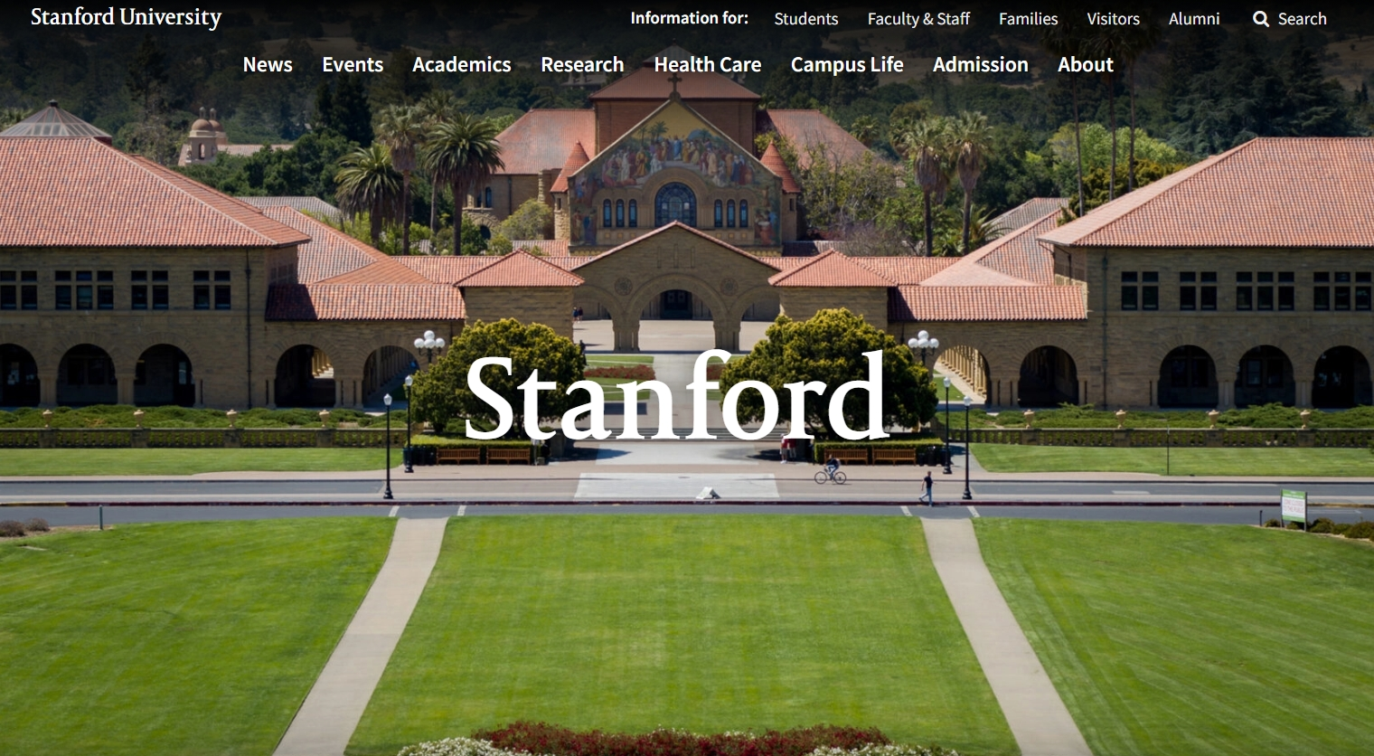
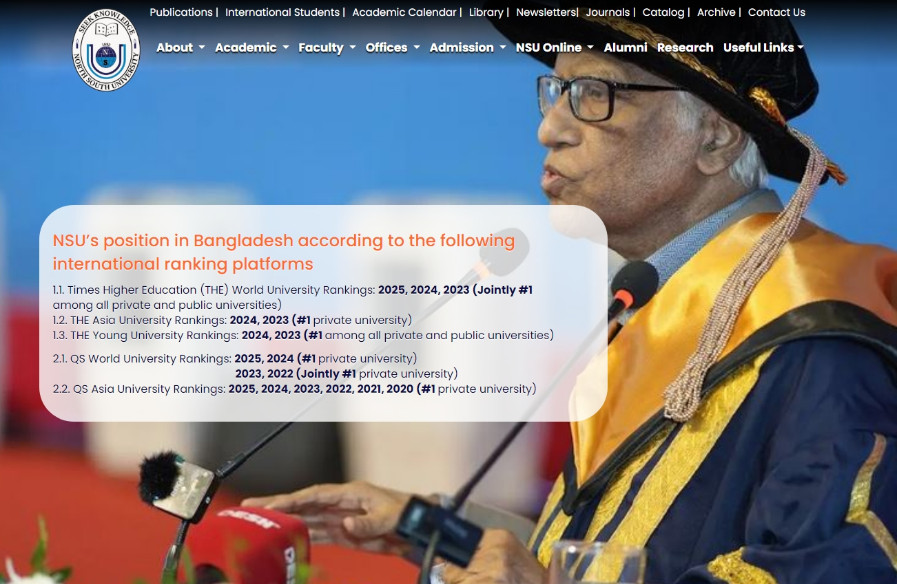
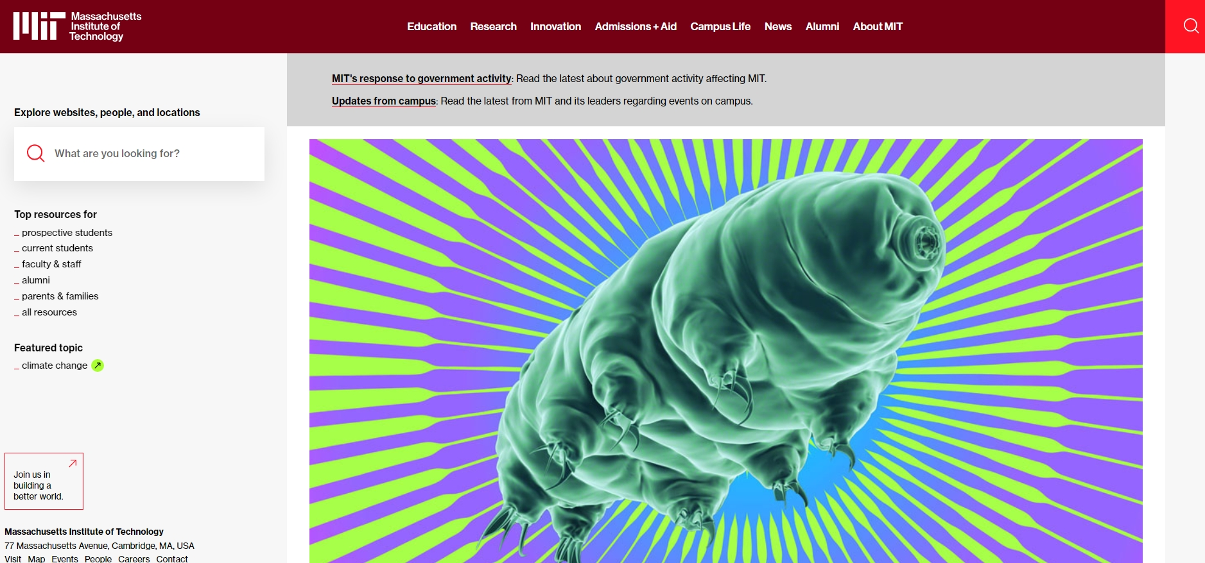

Slide 5
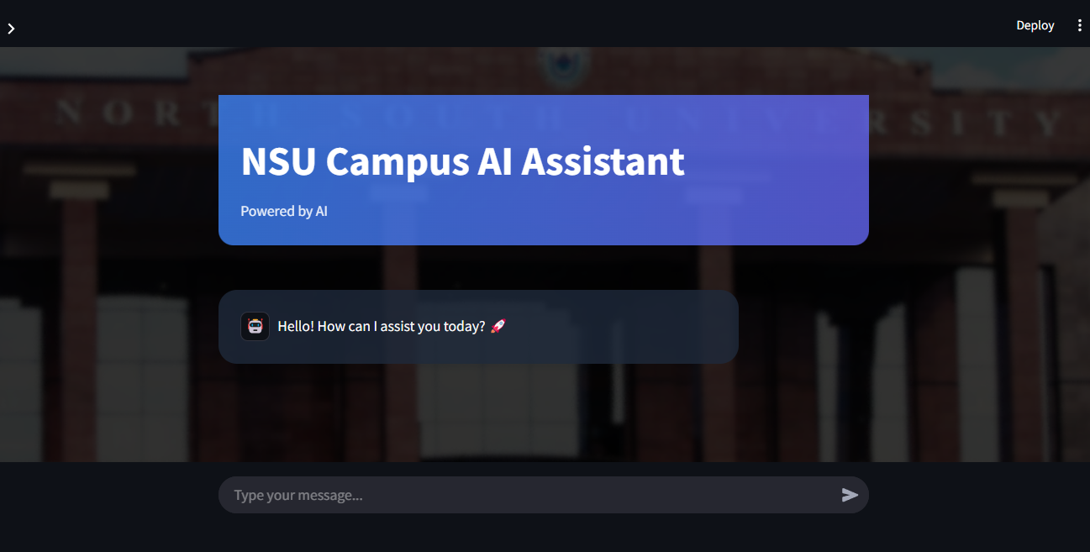

Slide 6
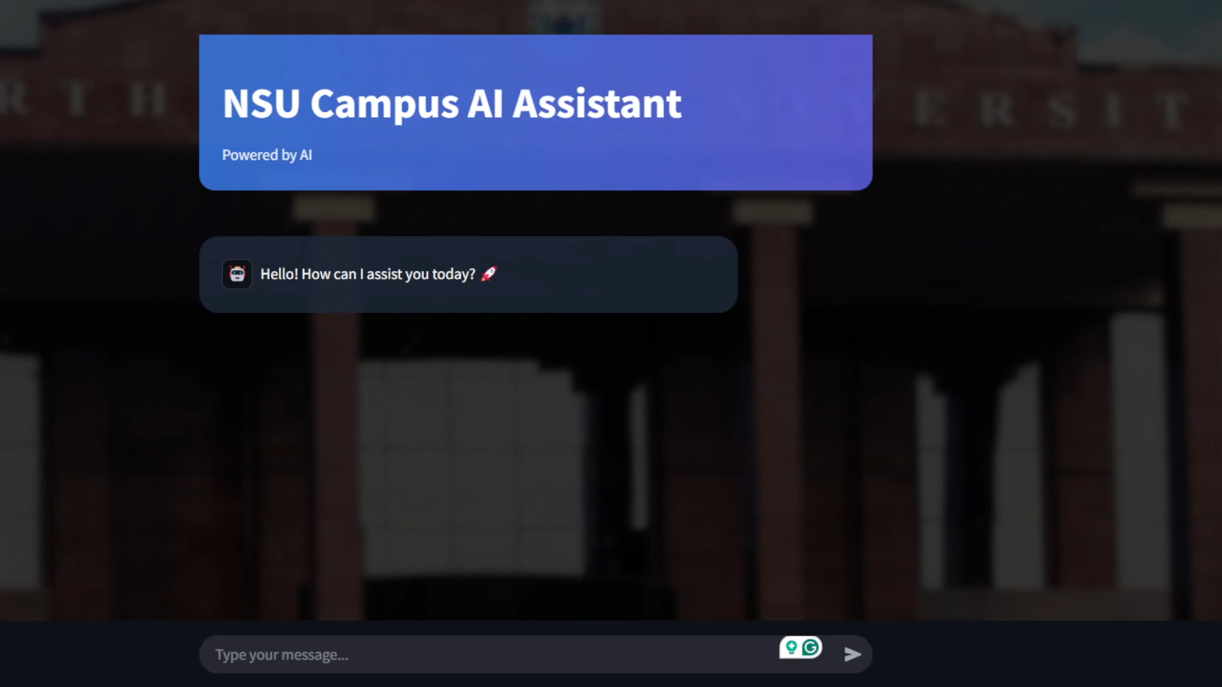


Slide 7
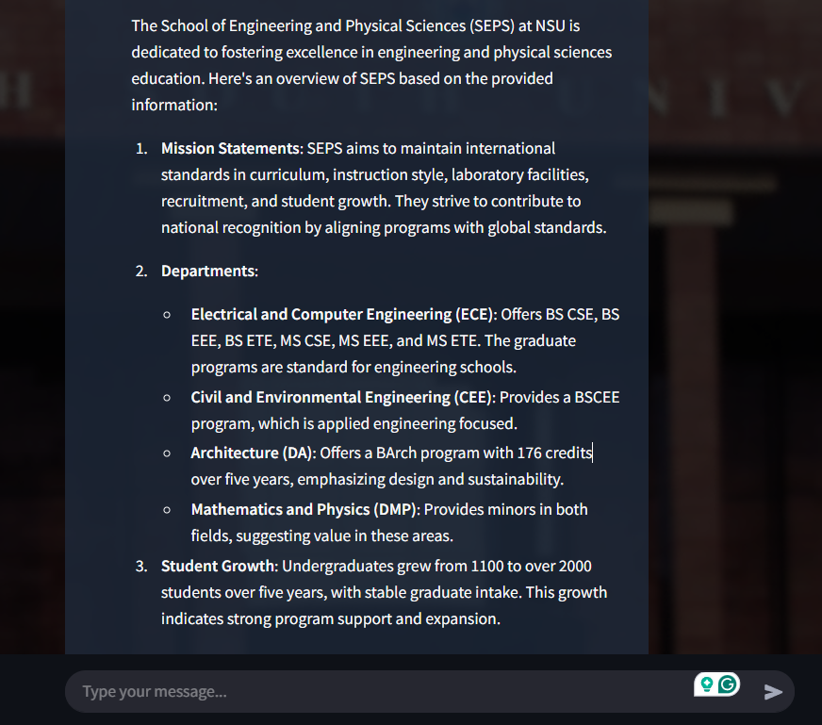
Enhanced Student Engagement – Provides an interactive AI chatbot for students to get quick responses to academic queries.
User-Friendly UI – Built with Streamlit, featuring an intuitive interface and real-time response generation.
Scalability & Adaptability – Can integrate more data sources and models, making it adaptable for future expansion.
Instant Academic Support – Students can quickly get answers to course-related questions, assignment guidelines, and university policies.

Slide 8
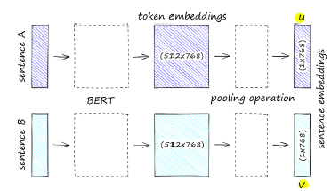
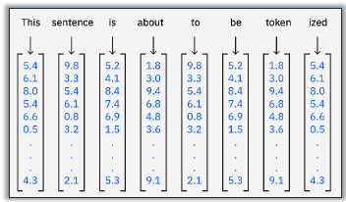
Technical Details
🧠 Sentence Transformers
📦 Vector Database
Converts text (like a user query or document content) into dense numerical vectors
Stores and searches vector embeddings quickly.
🔁 RAG (Retrieval-Augmented Generation) Pipeline
🧬 LLM (Large Language Model)
Takes the retrieved content and the original user query to generate a natural-language response.

Slide 9


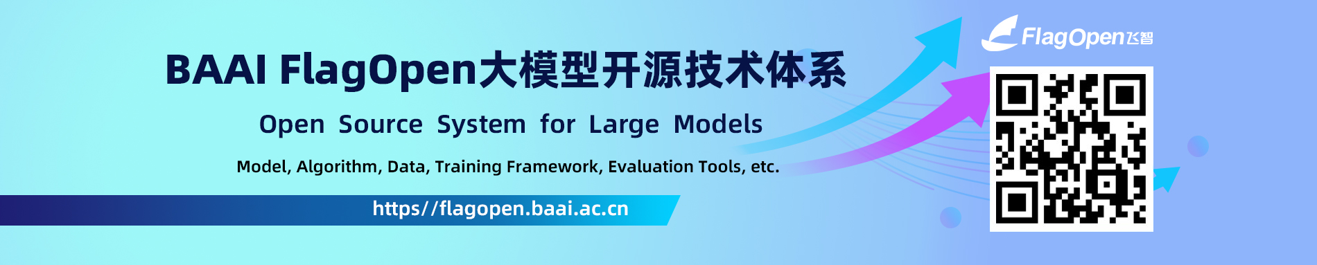


Technical Details
LLM (large language model): deep seek-r1 (1.5B parameters) for natural language understanding and response generation.
Vector database: FAISS (Facebook ai similarity search) for efficient document retrieval.
Embeddings model: sentence transformer (bge-small-en-v1.5) for semantic search.
Frontend: streamlit for an interactive web-based interface.
Backend: ollama API for real-time chat functionality.

Slide 10
Technical Details
Query Topic | Similarity
SEPS founding date | 0.385
SEPS enrollment | 0.351
SEPS departments | 0.738
ECE undergraduate programs | 0.799
B. Arch duration/credits | 0.828
NSU engineering ranking (THE 2023) | 0.846
SEPS vision | 0.460
SEPS mission | 0.294
Undergraduate intake growth | 0.669
CEE lab facilities | 0.604
Architecture new labs by 2023 | 0.782
SEPS engineering accreditation | 0.836

Slide 11
Thank You!

